Slide 1
OPERATING SYSTEMS
Fundamentals, Functions & Architecture

Slide 2
Computer System Components
Hardware
Software
CPU
Memory
I/O Devices
Compilers
Text Editors
Database Systems
Operating System (Kernel)
Interface between users/applications and hardware

Slide 3
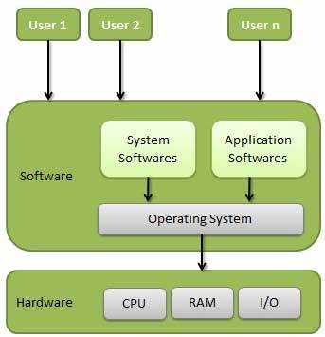
What is an Operating System?
A program running at all times on the computer (kernel)
Acts as interface between users and computer hardware
Manages hardware and controls resource usage
Provides efficient and convenient system usage

Slide 4
Operating System Objectives
Convenience
Make the computer system easier to use
Efficiency
Use system resources in an efficient manner
Evolvability
Support testing, development & addition of new components

Slide 5
OS as an Extended Machine
Hides Complex Hardware Details
Example: Disk Access
With OS (Simple):
Without OS (Complex):
Just specify:
Specify block address
Calculate sector numbers
Handle inter-sector gaps
File name
Data location

Slide 6
OS as a Resource Manager
OS Responsibilities:
Keep track of allocated resources
Grant resource requests when available
Account for resource usage
Resolve conflicts between different programs/users

Slide 7
Resource Multiplexing
Time Multiplexing
Space Multiplexing
Resources are shared turn-by-turn
Resources split into portions
Resource allocated to User A for T1
Then to User B for T2
Then to User C for T3
Example: CPU scheduling
Each user gets a portion simultaneously
Example: Main memory
Example: Disk storage
OS allocates and deallocates space

Slide 8
OS: User Point of View
Stand-Alone
Ease of use
Personal computers
Networked
Resource utilization
Multiple users competing
Handheld
Individual usability
Mobile devices
Embedded
Reliable operation
No user intervention

Slide 9
OS: System Point of View
The OS has two primary roles:
Resource Allocator
Control Program
Manages CPU time
Allocates memory
Controls I/O devices
Ensures efficient & fair distribution
Manages user programs
Prevents errors
Prevents improper system use
Controls I/O operations

Slide 10
Key Takeaways
OS is the bridge between users and hardware
Achieves convenience, efficiency, and evolvability
Functions as an extended machine and resource manager
Uses time & space multiplexing for resource sharing
Adapts to different computing environments

